Slide 1

AI Rehab Assistant
An AI tool to help patients understand physiotherapy exercises

Slide 2
Why I Built This Project
Personal Motivation
The Core Issue
This project was born from observing a real challenge: patients struggling to understand their physiotherapy exercise instructions at home.
Without their therapist present, patients face confusion that can lead to improper exercise execution, slower recovery times, and sometimes even injury.
Rehabilitation PDFs are often filled with technical terminology, unclear diagrams, and confusing instructions that leave patients uncertain about proper form and technique.
I wanted to explore how AI could bridge this gap and make rehabilitation guidance more accessible.

Slide 3


Understanding the Problem
Confusing Documentation
Incorrect Posture Risk
Exercise sheets use technical medical language that's difficult for patients to interpret without professional guidance.
Misunderstanding instructions leads to poor form, which can significantly delay recovery or cause additional strain.
No At-Home Support
Once patients leave the clinic, they're on their own to interpret and follow their exercise regimen correctly.

Slide 4
Project Goals
01
02
Clear Exercise Explanations
Interactive Question Answering
Transform complex rehabilitation instructions into simple, understandable language that patients can easily follow.
Allow patients to ask specific questions about their exercises and receive context-aware responses based on their prescribed program.
03
04
Context-Driven Guidance
Safe Information Boundaries
Use the patient's actual PDF documents to provide personalized, relevant answers that match their specific rehabilitation plan.
Provide helpful guidance while clearly staying within appropriate boundaries and not offering medical advice.

Slide 5





How the System Works
The AI Rehab Assistant follows a streamlined process to transform PDF exercise instructions into an intelligent, conversational interface.
PDF Upload
Patient uploads their exercise sheet
Text Extraction
System extracts and processes content
Vector Storage
Creates searchable embeddings in ChromaDB
Semantic Search
Finds relevant context for questions
AI Response
Generates clear, helpful answers

Slide 6

Key Features
1
2
PDF Document Upload
Interactive Chat Interface
Simple interface to upload physiotherapy exercise instructions in PDF format for processing and analysis.
Conversational system where patients can ask questions about their exercises in natural language.
3
4
Context-Based Answers
Safe Guidance Framework
Responses are generated using the actual content from the patient's uploaded documents for accuracy.
System provides helpful information while maintaining appropriate boundaries and avoiding medical advice.
5
Clean Streamlit Interface
User-friendly web application built with Streamlit for easy access and intuitive interaction.

Slide 7

System Architecture
The architecture leverages modern AI and NLP technologies to create an intelligent document understanding system.
PDF Processing
Text Splitting
Embeddings
Vector Store
Document Processing
Vector Storage & Retrieval
AI Response Generation
PyPDF2 extracts text, which is split into manageable chunks for embedding.
HuggingFace creates embeddings stored in ChromaDB for semantic search.
Groq LLM generates answers using retrieved context, displayed via Streamlit.

Slide 8
Technologies Used
Python
Streamlit
Core programming language for building the entire application backend and orchestrating all components.
Web framework for creating the interactive user interface with minimal code and rapid development.
LangChain
ChromaDB
Framework for building applications with large language models, handling document processing and prompts.
Vector database for storing and retrieving document embeddings with fast semantic search capabilities.
Groq API
HuggingFace
Fast inference API for running large language models to generate intelligent, context-aware responses.
Provides pre-trained embedding models for converting text into meaningful vector representations.

Slide 9
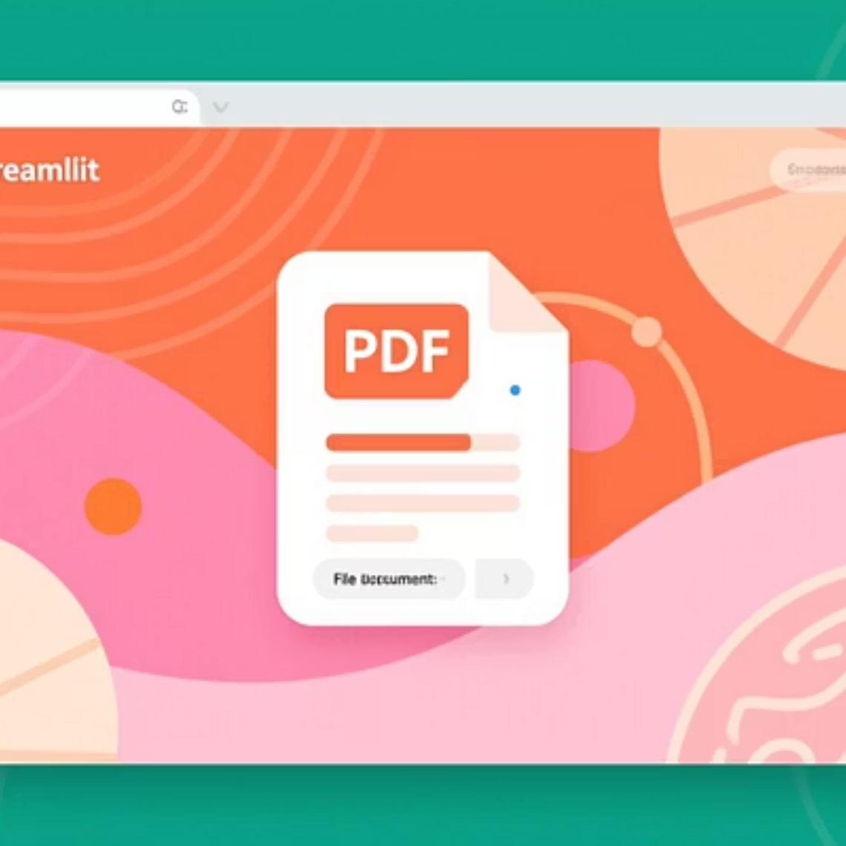
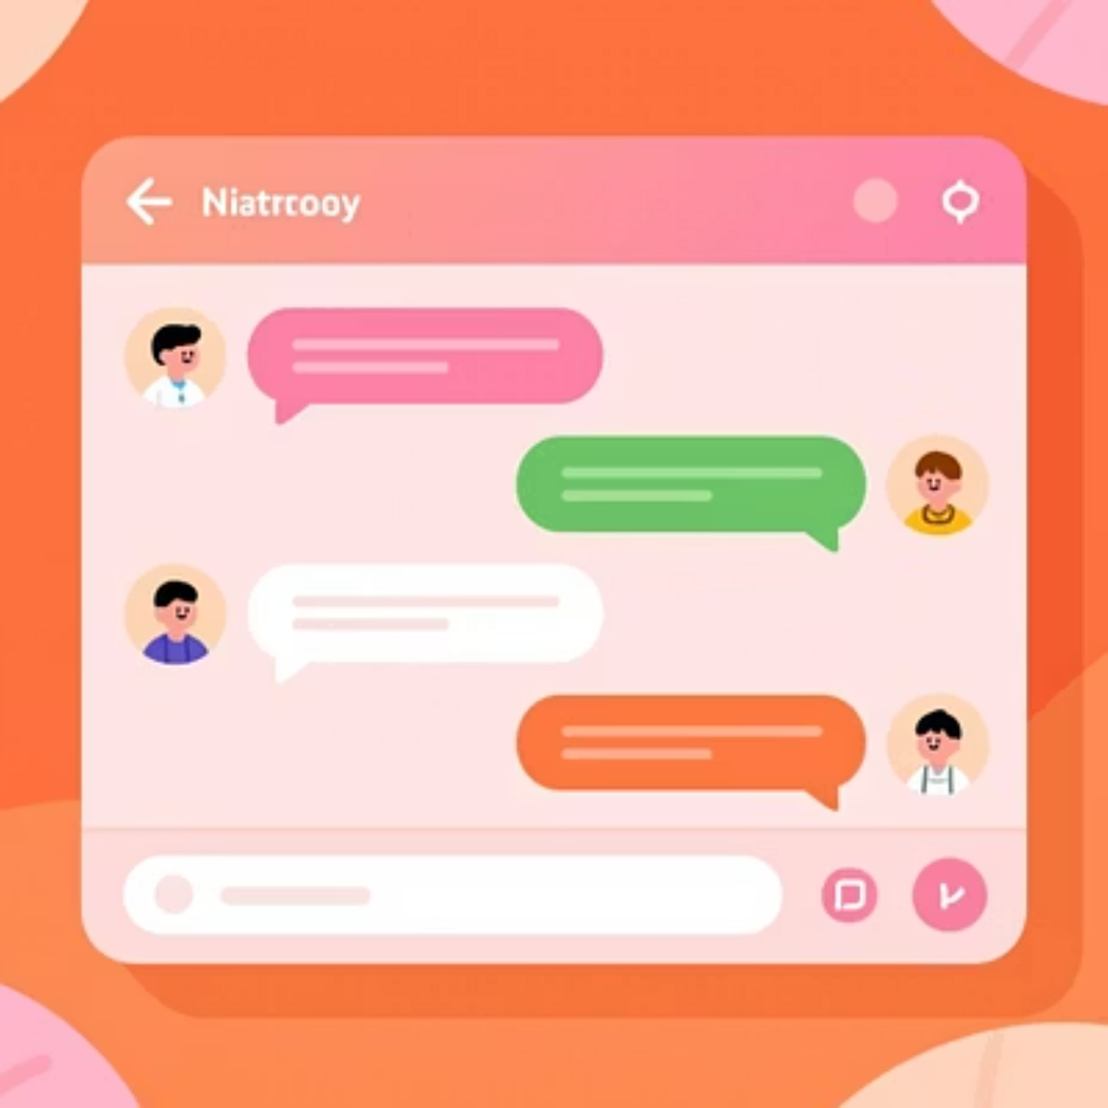
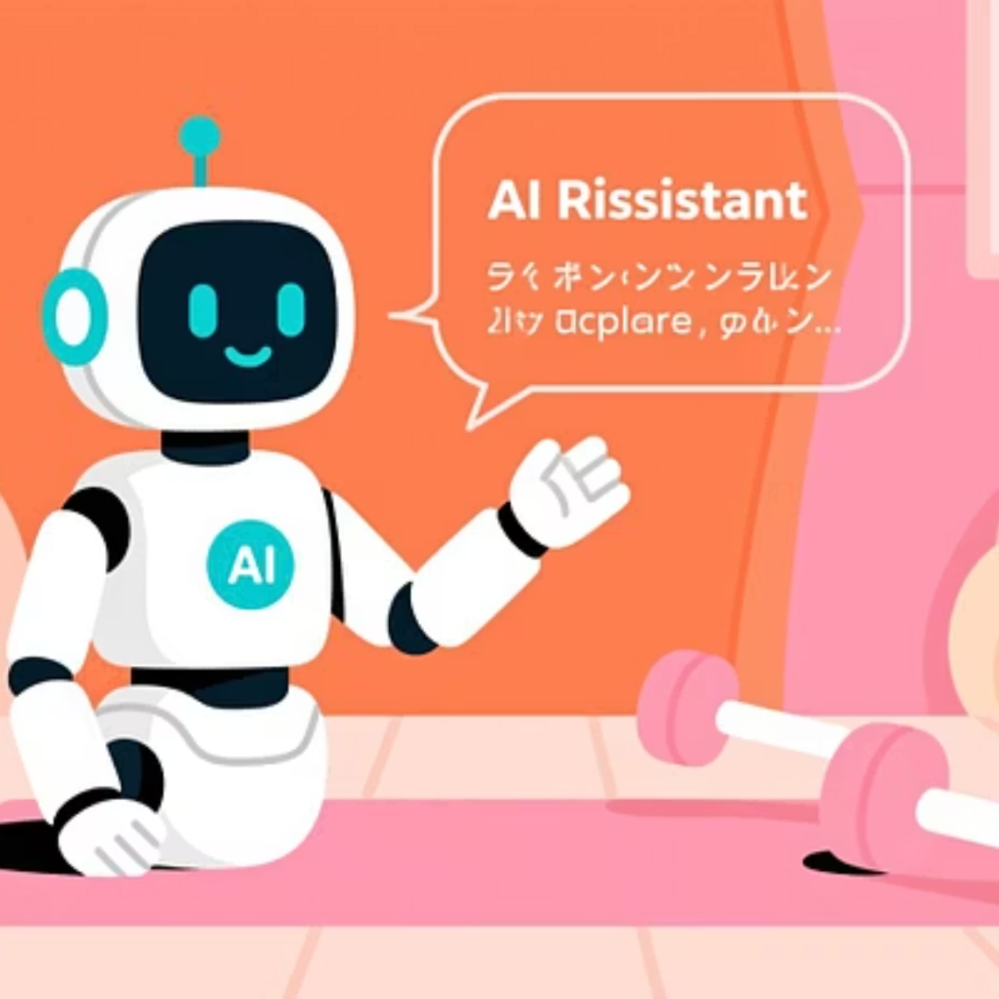
Application Interface
The user experience is designed to be intuitive and straightforward, focusing on ease of use for patients of all technical backgrounds.
Upload Screen
Chat Window
Answer Display
Simple drag-and-drop or browse interface for PDF uploads
Clean conversation interface with question input and response display
Clear, formatted responses with relevant context from the document

Slide 10

What I Learned & Next Steps
Key Learnings
Future Improvements
Practical experience with RAG (Retrieval Augmented Generation) architecture and vector databases
Progress Dashboard: Track exercise completion and recovery milestones over time
Voice Assistant: Add voice input and output for hands-free interaction during exercises
Understanding how to process and chunk documents effectively for semantic search
Video Posture Analysis: Use computer vision to provide real-time feedback on exercise form
Working with LLM APIs and managing prompt engineering for domain-specific responses
Building user-friendly interfaces with Streamlit for AI applications
Multi-language Support: Expand accessibility to non-English speaking patients

